Slide 1
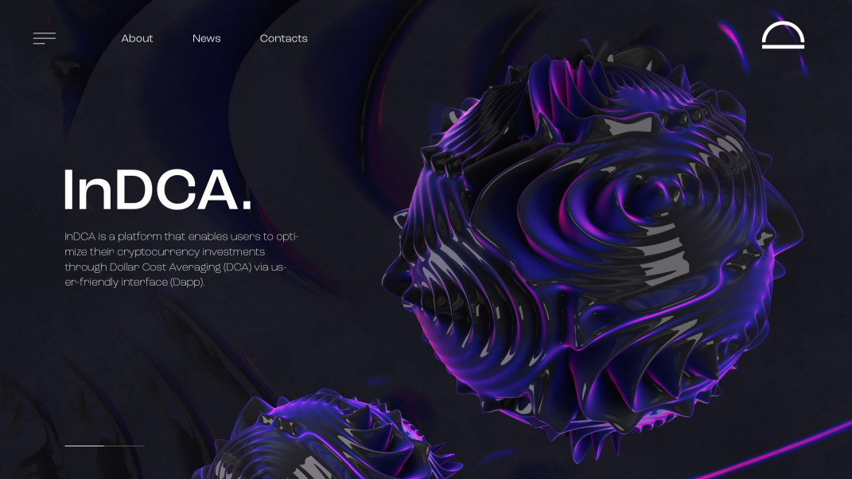



Notes:
https://unsplash.com/photos/TvN54bnuQg8

Slide 2

Notes:
https://unsplash.com/photos/AXu2aZ3YgP8

Slide 3
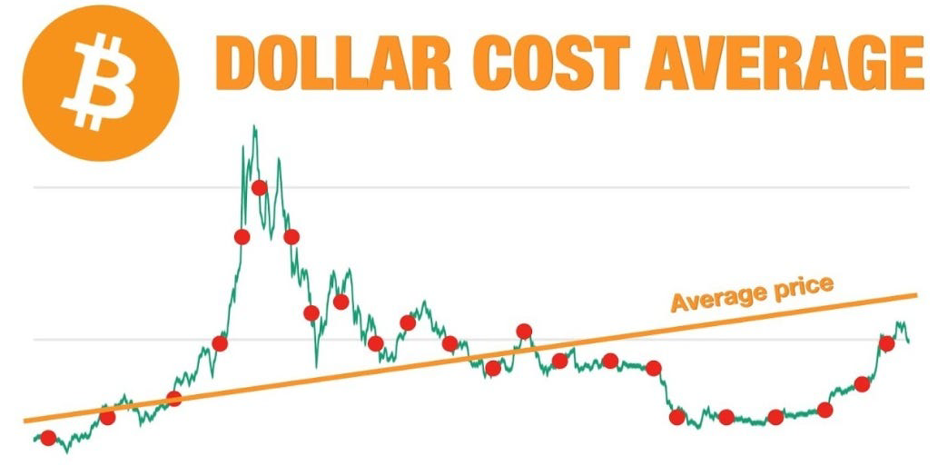

Slide 4
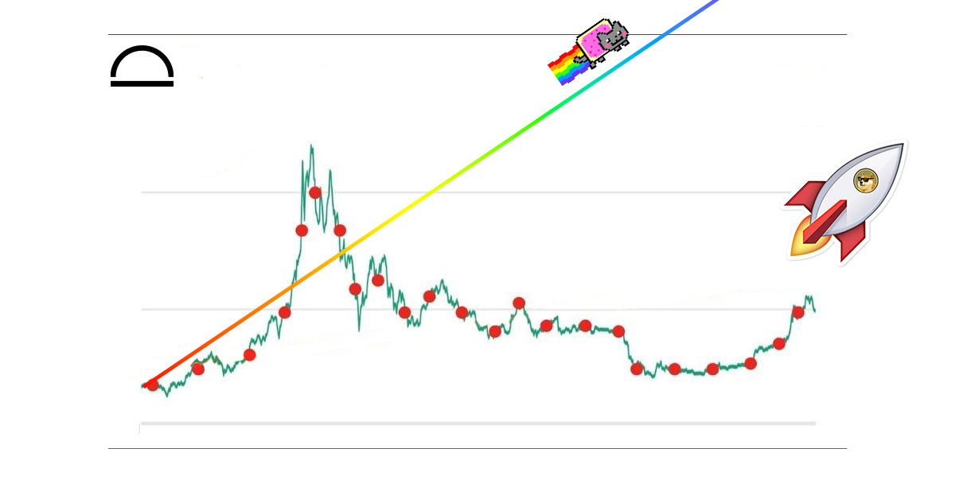

Slide 5
Notes:
https://unsplash.com/photos/TvN54bnuQg8

Slide 6
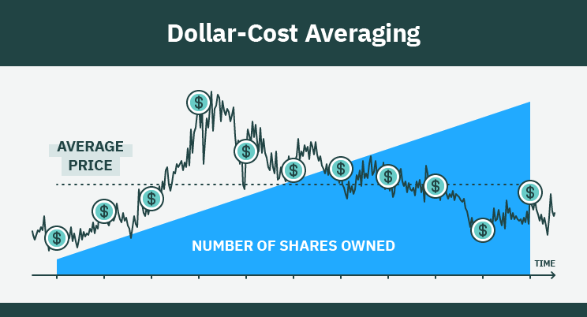
What is DCA ?
- Investment strategy which you invest fixed sum at regular interval.
- Used by long term investors

Slide 7
PROBLEM
NOT THE BEST MOMENT ?
YIELDS NOT ENOUGH AS MUCH

Slide 8
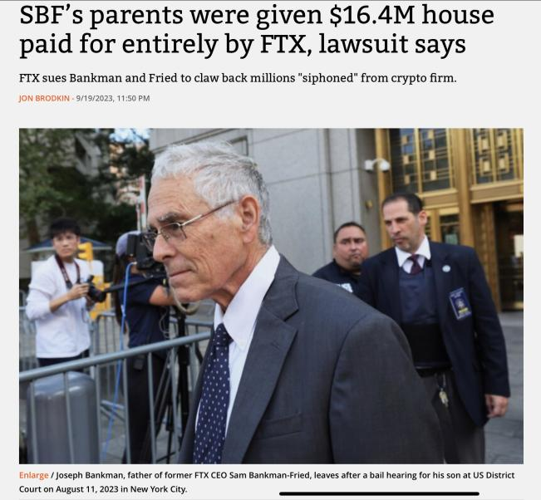
You own your keys !

Slide 9


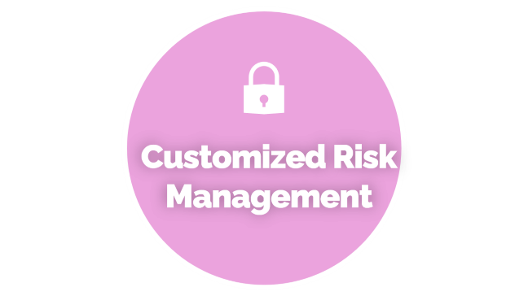



Notes:
https://unsplash.com/photos/AXu2aZ3YgP8

Slide 10

Investment Optimization

Slide 11
Investment Optimization
Maximize returns by using Dollar-Cost Averaging (DCA) in an intelligent way. By analyzing market indices, the platform identifies opportune times to invest, ensuring that every dollar invested has the potential to generate optimal returns
Notes:
https://unsplash.com/photos/fItRJ7AHak8

Slide 12

Simplicity and Accessibility

Slide 13
Simplicity and Accessibility
InDCA offers a user-friendly experience for both novice and experienced investors. The use of MagicLink for beginners and the integration of classic wallets such as MetaMask ensure broad accessibility. Registration is simple, eliminating barriers to entry for new cryptocurrency investors.
Notes:
https://unsplash.com/photos/fItRJ7AHak8

Slide 14

Customized Risk Management

Slide 15
Customized Risk Management
InDCA gives users control over their investment by allowing the customization of risk thresholds. Investors can set limits to protect their funds, offering peace of mind while maximizing return opportunities
Notes:
https://unsplash.com/photos/fItRJ7AHak8

Slide 16

USER EXPERIENCE
SMART CONTRACT
SWAP AND DEX
Technical Part
Notes:
https://unsplash.com/photos/fItRJ7AHak8

Slide 17
Business Model
Cost Structure:
Development maintenance Security, compliance
Key Partner:
Data suppliers
Onramp suppliers
Key Activities:
Platform development Marketing Security
Revenue Stream:
ONE SWAP =1% Fees
Customer RelationShip
Customer support
Notes:
https://unsplash.com/photos/fItRJ7AHak8

Slide 18

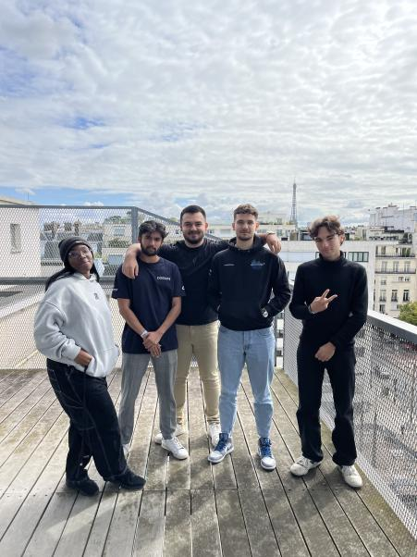
Maksym Andrushkiv – CEO
Marc-antoine Ourradour - CTO
Adrien Burkhardt - CFO
Aminata Cisse - CMO
Kamil Merzouki - CDO

